Slide 1
Life Transitions: Easing Into Parenthood
Team: #7
Team Name: The Seven
Team Members: Mehroos Ali, Soumadeep Basu, Mary Grace Kozuch, Sudarshan Athreya Suresh

Slide 2
Three Tasks
Simple: Updating the application with general personal hobbies or goals and being shown nearby activities related to the users goals. The activities will also align with schedules.
GOAL: User wants to track their personal hobbies and goals
Moderate: After completing a goal the user will update the app with this information and be offered rewards for staying on track.
GOAL: User needs an incentive to prioritize their mental health while still caring for their child
Complex: Continually updating the application through easy to use options when time needs to be taken to care for the child. This will generate a calendar with the predicted baby care times and user hobby times.
GOAL: User needs to integrate their old life with their new schedule for the baby

Slide 3
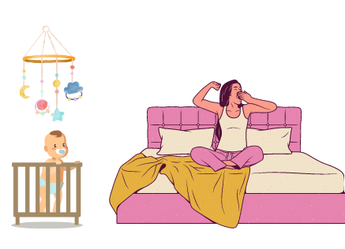

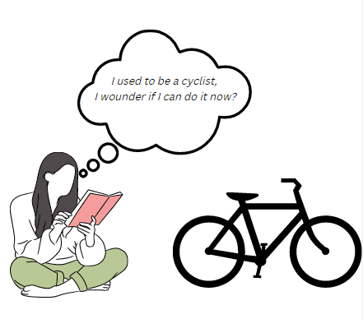
Video Planning Storyboard

Slide 4
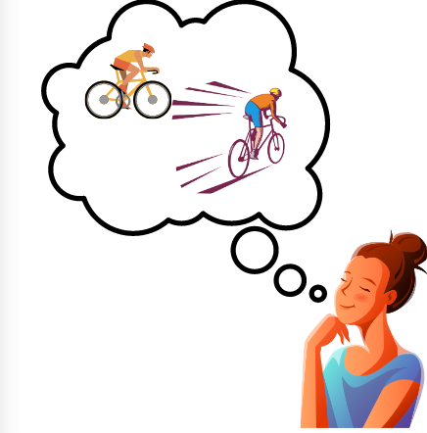
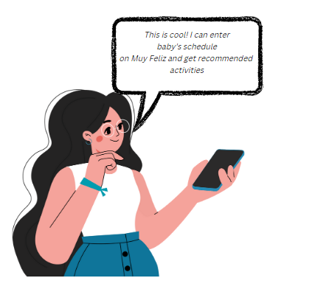
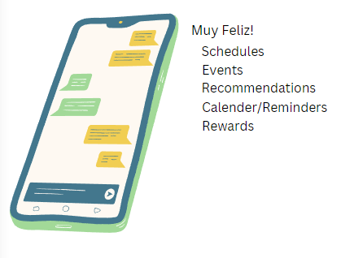
Video Planning Storyboard

Slide 5



Video Planning Storyboard

Slide 6
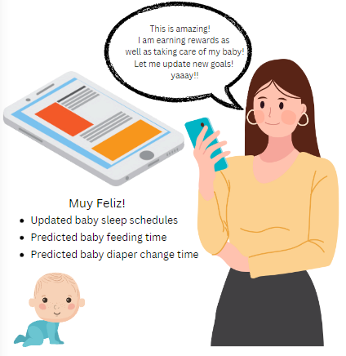

Video Planning Storyboard

Slide 7
Video
https://www.youtube.com/watch?v=otUhegrqgK4
Length Notes: Full content included between 0:00-2:40
Last minute provides a clarity and culmination to problem and credits.

